Slide 1
High cloud airlines analysis Presentation
Presented By
Group6

Slide 2
OUR TEAM MEMBERS
ABHAY SINGH RATHOD
AMARNATH
MALLIKARJUNA REDDY
MINAL HEMANTH SANGLE
NOWSHAD
SAHITHI

Slide 3
AGENDa
Introduction
Business Overview
Project Scope
Data Model challenges
Dashboard Overview
Suggestions and Comments

Slide 4
Objective
To gain a comprehensive understanding of ‘High Cloud Airlines operations through data analysis. This will involve investing load factor, identifying top carrier names based on passenger preference, Analyzing popular routes, and exploring other Key metrics. The Ultimate goal is to provide actionable recommendations that can Enhance operational efficiency and profitability.

Slide 5
Intoduction To HIGH CLOUD
● High cloud Airline, a leading player in the aviation sector, has been at the forefront of providing seamless air travel experiences.
● Established with a commitment to excellence, High cloud consistently set industry standards in terms of reliability, safety and customer satisfaction.
● Extensive network of routes spans across regions, connecting people and cultures, making High Cloud a preferred choice for millions of travelers globally.
● High Cloud embraces innovation and modern technology to enhance operational efficiency and stay at the forefront of the aviation landscape.

Slide 6
Business Overview
In Today’s competitive airline industry, data analysis plays a critical role in optimizing operations and maximizing profitability. By harnessing the power of data, High Cloud Airlines can give valuable insights into various aspects of its business, allowing them to make data-driven decisions that can lead to
● Impoved Load Factor
● Enchanced Passenger Experience
● Optimized Resource Allocation
● Data-Driven Decision Making

Slide 7
Project SCOPE
This Project aimed to leverage the power of data analysis and extract valuable insights to optimize High Cloud Airlines operations and performance . The specific scope of the project focused on analyzing key performance indicators (KPIs) to gain a deeper understanding of:
● Load Factor
● Passenger Preferences
● Popular Routes
● Operational Efficiency

Slide 8
Data Model Challenges
Throughout our analysis, we encountered various challenges in handling the data. Overcoming these challenges is crucial for accurate insights
. Data Volume: Managing and processing large datasets efficiently. . Data Quality: Ensuring accuracy and reliability of the data. . Complex Relationships: Establishing connections between different data points.

Slide 9
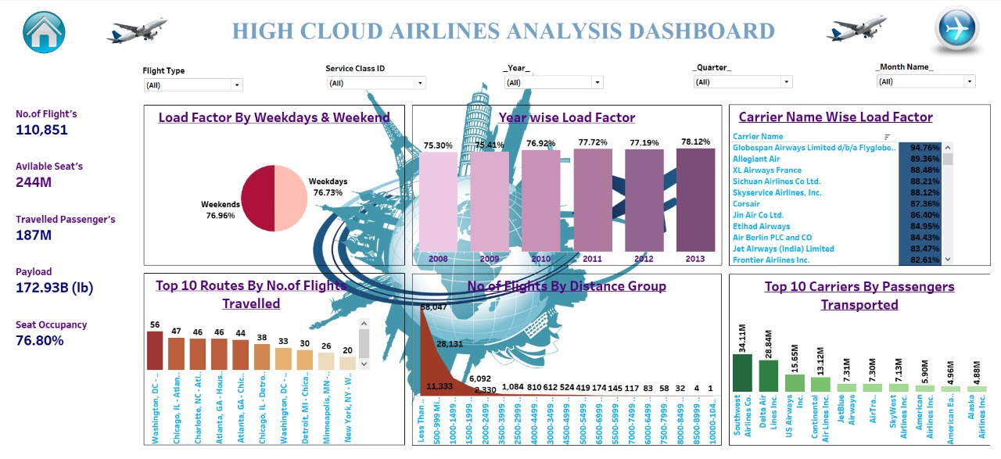
DASHBOARD OVERVIEW – Using Tableau Tool

Slide 10
Recommendations
● Optimize flight Routes: Utilize insights from top routes and flights to optimize schedule and resource allocation.
● Enhance Load Factor: Leverage load factor analysis to identify trends and implement strategies for increased efficiency.
● Strategic Carrier Partnerships: Collaborate with top carriers to maximize passengers transportation and enhance overall performance.
● Resource Allocation: Allocate resources strategically based on flight schedules and passengers volume data. This ensures efficient operations and minimizes wait times at airports with high passenger traffic.

Slide 11
Conclusion
High cloud Analysis empowers the aviation industry with actionable insights, fostering efficiency and strategic decision-making.
The presented KPIs offer a glimpse into the vast potential for improvement and growth within the industrt.
By harnessing the power of data, we can drive positive changes, ensuring a brighter future for High Cloud Analysis and its partners in the aviation sector.

Slide 12
THANK YOU

